Slide 1
Introduction to Statistical Thinking

Slide 2
Scale of measurement

Slide 3
Branch of statistics
Data can be qualitative or quantitative. A qualitative data is observed and recorded, for example gender while quantitative data is the type of data that arise as a result of numerical estimation or measurement, for example weight of a person. Both qualitative and quantitative have their scale of measurement.

Slide 4
Scale of measurement
In the other hand, each level of measurement scale has specific properties that determine the various use of statistical analysis or approach. The four types of scales at which we can categorize data are:
Nominal
Ordinal
Interval
ratio

Slide 5
Nominal scale
It is used for identification purposes
It is also known as qualitative or categorical variable scale for labeling variables into distinct classifications
The only statistical analysis for a nominal scale is frequency and percentage
It can also be analyzed graphically using a bar chart or pie chart
The most common measure of central tendency for the nominal variable is the mode.

Slide 6

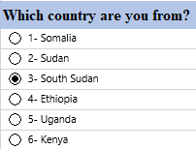
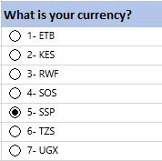
Examples of Nominal
Other examples include ethnicity, religion, and languages spoken. When a nominal variable has two categories or levels it is called a binary variable.

Slide 7
Ordinal scale
The ordinal scale allows for rank order (1st, 2nd, 3rd, 4th, etc.) by which data can be sorted, but still does not allow for relative degree of difference between them.
Ordinal represents the “order.”
The attributes on an ordinal scale are usually arranged in ascending or descending order.
Ordinal data is known as qualitative data or categorical data.
The most common measure of central tendency for the ordinal scale data is the median while the mode is also allowed.

Slide 8
Examples of Ordinal
Ranking of students’ performance in CS 3
1st
2nd
3rd
Assessing the degree of agreement
Totally agree
Agree
Neutral
Disagree
Totally disagree
How would you rate this lecture?
Excellent
Very Good
Good
Bad
Poor

Slide 9
Interval scale
It is a quantitative measurement scale in which the difference between the two variables is meaningful
Interval scale indicates distance between two entities
The classic example of an interval scale is Celsius temperature because the difference between each value is the same. For example, the difference between 70 and 60 degrees is a measurable 10 degrees, as is the difference between 90 and 80 degrees.

Slide 10
Interval scale
The interval type allows for the degree of difference between items, but not the ratio between them.
We can use mode, median, and arithmetic mean as a measure of central tendency in the interval scale while range and standard deviation can be used as measure dispersion.

Slide 11
Ratio scale
The ratio scale is the 4th level of measurement scale, which is quantitative.
It is an extension of the interval scale which possesses a meaningful absolute zero value and because of this, it doesn’t have negative value.
The ratio scale is compatible with all statistical analysis methods like the measures of central tendency and measures of dispersion Examples of ratio scale include height, age, weight, and length.

Slide 12
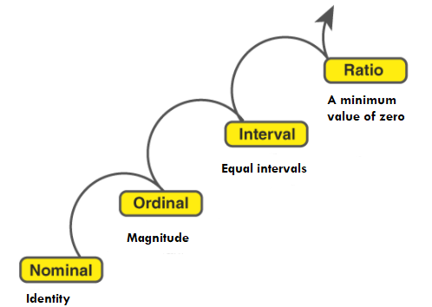
Pictorial summary of scale of measurement

Slide 13
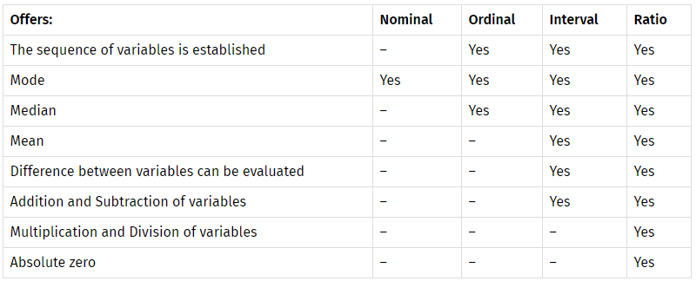
Scale of measurement and measure of central tendency

Slide 14


